Slide 1
‘Just’ the flu…?
Key messages
Winter 2020

Slide 2
On average, how many people die from the flu in the UK every year?
0
2,500
11,000

Slide 3
The flu kills 11,000 people on average every year and many more people need hospital care
There’s no ‘just’ about it

Slide 4
How does the flu spread from person to person?
When you’re asleep
From being outside in the rain
Through droplets that come from your nose or mouth when you cough or sneeze

Slide 5
The flu virus spreads from person to person through droplets that come from your nose or mouth when you cough or sneeze
Not every one will show symptoms

Slide 6
Some people are said to be more ‘at risk’
This means they’re more likely to develop more serious complications if they were to get the flu
These people are eligible for a FREE flu jab!
Who do you think these
people might be?

Slide 7
This year, the NHS is offering a free flu jab to:
Pregnant women
Children aged 2- 11 years old
65+ years old
Those who were members of a shielding household
Frontline health and social care workers
People with a long term health condition – what do you think these might be?

Slide 8
This year, the NHS is offering a free flu jab to:
Those with a long-term health condition such as:
a heart problem
a chest complaint or breathing difficulties e.g bronchitis, emphysema or severe asthma
a kidney disease
lowered immunity due to disease or treatment, e.g steroid medication or cancer treatment
liver disease
had a stroke or a “mini stroke” known as a transient ischaemic attack (TIA)
diabetes
a neurological condition, e.g. multiple sclerosis (MS), cerebral palsy
a learning disability
a problem with your spleen, e.g. sickle cell disease, or you had your spleen removed
are seriously overweight - BMI of 40 and above

Slide 9
What do you need to do to get your free flu jab? a) Wait for my GP to write to or text me b) Contact my GP to see if I am eligible c) Book an appointment at my local pharmacy

Slide 10
Getting your free flu jab
All of the above!
Your GP practice will contact you by letter or text to book in
Invites will be sent from the end of September throughout the flu season & you can contact your GP for more information
Book an appointment at your local pharmacy if you’re over 18
Those who were members of a shielding household won’t be invited for a jab, but can request one from their GP
There are different strands of flu each year and new vaccines are developed to help protect you
If you are identified as being ‘at risk’ it’s important to have the flu vaccine every year to stay protected

Slide 11
What do you do if you want the flu jab but aren’t eligible for a free one? a) don’t get one b) pay privately at your local pharmacy c) ask your GP

Slide 12
What do you do if you want the flu jab but aren’t eligible for a free one?
All of the above
The NHS really wants those who are most at risk to be vaccinated first
If you are healthy, there is a really low risk of you becoming seriously ill, and may just experience symptoms like a sore throat, cough or aches
There are limited numbers of vaccines so its really important for the most vulnerable groups to have their jab over the next few months
If you’d like, you do have the choice to pay for a private vaccine at your local Boots/pharmacy it would cost approximately £14
If you think you might be eligible for a free vaccine, but haven’t heard from your GP – just give them a call!

Slide 13
How are children given the flu vaccine? a) In a sweet b) In a nasal spray c) An injection

Slide 14
Children are given the flu vaccine in a nasal spray
If unable to have the nasal spray, you can discuss with your child’s nurse/GP for alternative options
Children can receive the vaccine from their GP or local school

Slide 15
Why might some faith groups not want their children to have the nasal spray vaccine? a) The nasal spray contains gelatine that comes from pork b) Children don’t like spray going up their nose! c) They use other methods

Slide 16
The nasal spray for children contains porcine gelatine
Why?
Porcine gelatine is used in vaccines as a stabiliser – to ensure that the vaccine is safe when it is stored
Unlike the gelatine used in foods, the product used in vaccines is purified and broken down into very small molecules
Is there an alternative? If a child is at high risk and can’t have the nasal vaccine they can have the injection which doesn’t include gelatine

Slide 17
Is the flu vaccination safe? Are there side effects?

Slide 18
Is the flu vaccination safe? The flu vaccine is the best protection we have against this strain of flu virus, and studies have shown that it does help to prevent flu Are there side effects? Some people may experience a mild temperature, sore arm or slight muscle aches for a day or so This is entirely normal & serious allergic reactions are rare

Slide 19
Will the flu jab protect you against Covid-19? a) Yes b) No c) I don’t know

Slide 20
Will the flu jab protect you against Covid-19? No, the jab will just protect you from the flu – it’s designed to target this season’s strain of flu and nothing else

Slide 21
How will you know if you have flu or Covid-19? a) Just guess b) Your temperature will be higher if you have covid c) You won’t know

Slide 22
Both have similar symptoms so it may be difficult to tell If you show symptoms of Covid-19 - a high temperature - new continuous cough - loss of taste/smell It’s really important to self isolate and request a test by calling 119 or visiting www.nhs.uk/coronavirus
How will you know if you have flu or Covid-19?

Slide 23
If you’re not feeling well, what NHS services are available to help?
How do you contact them?

Slide 24
Monday – Friday
GP – call your GP / visit their website
24/7 – especially good if your GP is closed or you need urgent help
NHS 111 – call 111 / visit www.111.nhs.uk
In an emergency
Call 999 – if you feel your life is in danger
24/7 mental health support
CNWL single point of access 0800 0234 650
Samaritans 116 123

Slide 25
What can you do to help raise awareness & help protect people against flu this year?

Slide 26
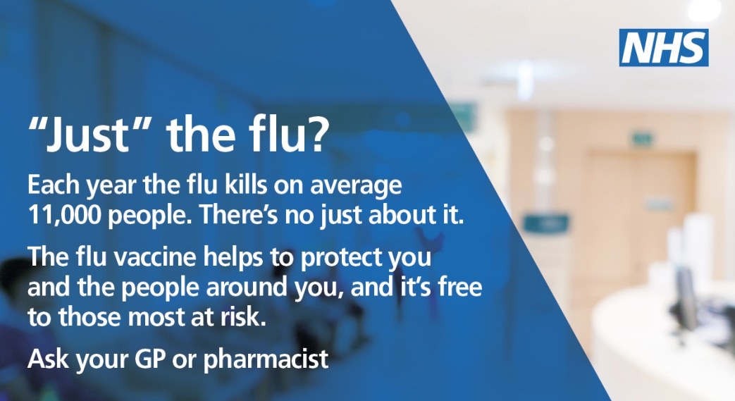
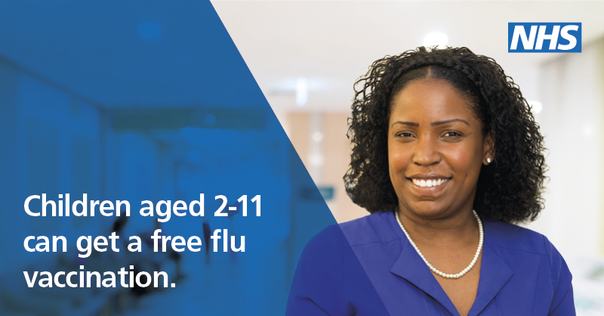
Look out for our campaign across North West London!

Slide 27
More information
Visit nwlondonccgs.nhs.uk for information to download & share about the flu – translations available in 13 languages
For more information on the flu vaccine nhs.uk/conditions/flu
Find out if your local pharmacy is offering the jab visit https://myvaccinations.co.uk/ or for Boots pharmacies www.boots.com/online/pharmacy-services/
Visit https://www.nhs.uk/coronavirus for the latest Covid-19 information and guidance

Slide 28
Contact details
Carrie Hirst
carrie.hirst@nhs.net
Engagement & Partnership Manager
West London CCG

